Slide 1
THE RELATIONSHIP AMONG THE THREE BRANCHES OF THE U.S. GOVERNMENT
Catherine M. Brown, Esq.
cmb.certcivatty@gmail.com
© Catherine M. Brown, Esq., All Rights Reserved, 2022

Slide 3
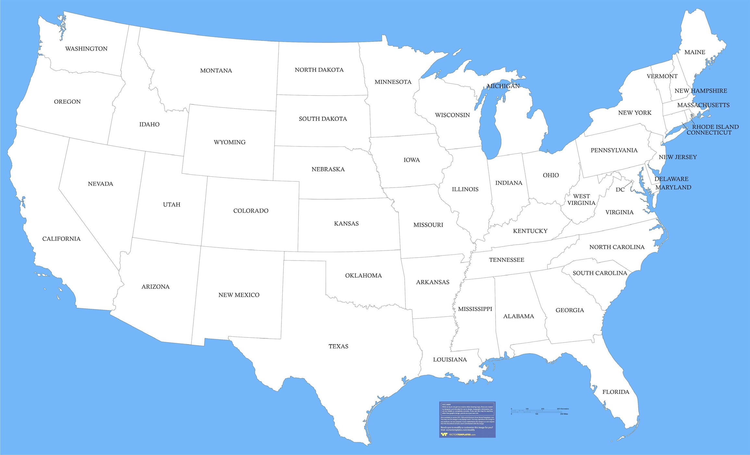

Slide 4
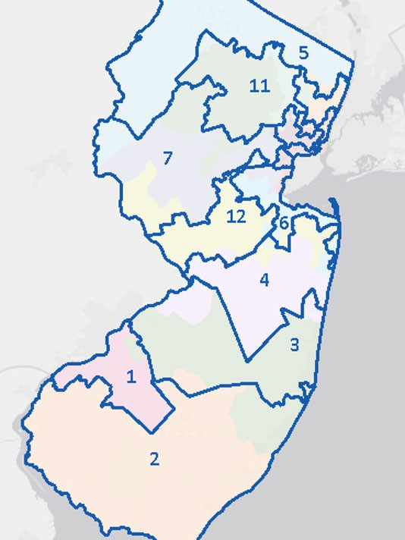

Slide 6
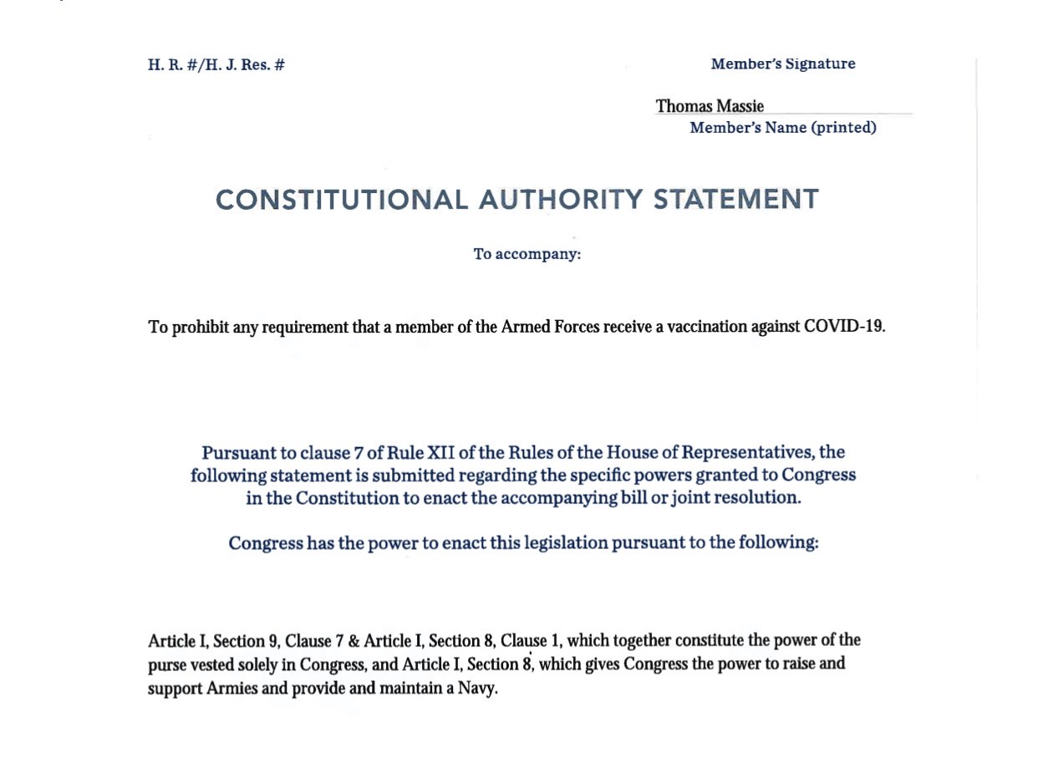

Slide 7
Excerpt: Marbury v. Madison, 5 U.S. (1 Cranch) 137 (1803)
“That the people have an original right to establish, for their future government, such principles as, in their opinion, shall most conduce to their own happiness, is the basis on which the whole American fabric has been erected. The exercise of this original right is a very great exertion; nor can it nor ought it to be frequently repeated. The principles, therefore, so established are deemed fundamental. And as the authority, from which they proceed, is supreme, and can seldom act, they are designed to be permanent.
***
The powers of the legislature are defined and limited; and that those limits may not be mistaken or forgotten, the constitution is written. To what purpose are powers limited, and to what purpose is that limitation committed to writing; if these limits may, at any time, be passed by those intended to be restrained? *** It is a proposition too plain to be contested, that the constitution controls any legislative act repugnant to it; ….
***
Certainly all those who have framed written constitutions contemplate them as forming the fundamental and paramount law of the nation, and consequently the theory of every such government must be, that an act of the legislature repugnant to the constitution is void.”
[Marbury v. Madison, 5 U.S., (1 Cranch) 137, 176-178 (1803)(emphasis added)].

