Slide 1
THE RELATIONSHIP BETWEEN THE U.S.GOVERNMENT
AND THE INDIVIDUAL
Catherine M. Brown, Esq.
cmb.certcivatty@gmail.com
© Catherine M. Brown, Esq., All Rights Reserved, 2022

Slide 2
What is in The Bill of Rights?
Protection of the ‘free mind’ (Liber):
First Amendment: no State-sponsored religion (Establishment Clause) free exercise of religion (Freedom of worship); freedom of Speech;
freedom of the Press (indirectly, the right to be informed); freedom of peaceable public assembly;
right to petition the Government for redress of grievances.
Protection of Person and Property from direct governmental tyranny: Second Amendment: keep and bear arms;
Third Amendment: In peacetime, no housing of soldiers without owner’s consent; in wartime, only as allowed by law.
Identifying the procedures necessary before the government may extinguish an individual’s liberty:
Fourth Amendment: freedom from searches and seizures of person or property; Judicial warrant based upon sworn statement;
probable cause required to obtain a warrant;
Fifth Amendment: right to criminal process initiated by a Grand Jury; Indictment (finding probable cause to charge; not random) no Double Jeopardy;
no self-incrimination in a criminal case;
may not be deprived of life, liberty or property without due process of law (applies to civil as well as criminal proceedings);
private property may not be taken for public use, without just compensation.
Sixth Amendment: criminally accused has right to a ‘speedy and public trial”;
right to trial by impartial jury in locale where crime committed; right of prior notice of criminal charge;
right to confront and cross-examine adverse witness; right to compel testimony of witness;
right to an attorney.
Eighth Amendment: pretrial: excessive bail not allowed;
post-convict: no cruel/unusual punishment or excessive fines.
Why is the Seventh Amendment In the Bill of Rights? Jury trial for a civil action.
1

Slide 3
The Contours of the Bill of Rights: The Personal Experience of Liberty:
The Limited Reach of the Bill of Rights: State actor or not?
When is a non-governmental official a state actor? ‘public function theory,’ Marsh v. Alabama, 326 U.S. 501 (1946)
  Food for thought: Are the owners of social media platforms state actors or not?
  What about Section 230? “Section 230 of the Communications Decency Act (CDA) of 1996 provides immunity from liability for providers and users of an "interactive computer service" who publish information provided by third-party users” [Wikipedia]
Additional Limitations of the Bill of Rights: Even when the Bill of Rights applies, its rights are not absolute; they may be restricted if there is a compelling governmental interest and the impingement is the least necessary and the law is narrowly drawn to fulfill its purpose. In sum, there is always a balance between legitimate governmental action that may touch upon fundamental rights and the exercise of those rights.
  e.g., COVID-19 and the right to worship in 2020.
Expansion of the Bill of Rights to the States: Selective Incorporation: Before the Fourteenth Amendment, the Bill of Rights by its terms is limited to the federal Government. In the 20th Century, the Supreme Court began to
incorporate its rulings about several of the Bill of Rights Amendments into the Due Process Clause of the Fourteenth Amendment. Currently, the rights of the First, Fourth, Sixth and (most of) the Fifth and Eighth have been incorporated into the Fourteenth Amendment. The result is the standardization of civil rights nationwide.
Further Expansion of Rights Jurisprudence over the States: Substantive Due Process: A related development is the modern Supreme Court’s use of the Due Process Clause of the Fourteenth Amendment to identify as “fundamental” rights not specifically mentioned in the Bill of Rights. The legal theory is that the Clause expresses ‘substantive’ as well as ‘procedural’ rights. When a substantive fundamental right is found in the Due Process Clause, it invalidates a duly-enacted State law to the contrary.
What is a Fundamental Right? The Bill of Rights are enumerated fundamental rights. Fundamental rights are those which are foundational to the design of the Constitution, because they are aspects of liberty inherent to our human nature. Absent a compelling governmental interest, fundamental rights override any law that curtails them.

Slide 4
Re: First Amendment - Freedom of the Press
EXCERPT: TAH v. GLOBAL WITNESS PUBLISHING, Inc., (D.C. Cir., Dkt. No.
19-7132 (Consol)(DISSENT: Silberman, J.)
***
III
After observing my colleagues’ efforts to stretch the actual malice rule like a rubber band, I am prompted to urge the overruling of New York Times v. Sullivan. Justice Thomas has already persuasively demonstrated that New York Times was a policy-driven decision masquerading as constitutional law. See McKee v. Cosby, 139 S. Ct. 675 (2019) (Thomas, J., concurring in denial of certiorari).
The holding has no relation to the text, history, or structure of the Constitution, and it baldly constitutionalized an area of law refined over centuries of
common law adjudication. See also Gertz v. Robert Welch, Inc., 418 U.S. 323, 380–88 (1974) (White, J., dissenting). As with the rest of the opinion, the actual malice requirement was simply cut from whole cloth. New York Times should be overruled on these grounds alone.
Nevertheless, I recognize how difficult it will be to persuade the Supreme Court to overrule such a “landmark” decision. After all, doing so would incur the wrath of press and media. See Martin Tolchin, Press is Condemned by a Federal Judge for Court Coverage, New York Times A13 (June 15,1992) (discussing the “Greenhouse effect”). But new considerations have arisen over the last 50 years that make the New York Times decision (which I believe I have faithfully applied in my dissent) a threat to American Democracy. It must go.
1

Slide 5
EXCERPT FROM U.S. SENTENCING GUIDELINES:
PART K - DEPARTURES
1. SUBSTANTIAL ASSISTANCE TO AUTHORITIES
§5K1.1. Substantial Assistance to Authorities (Policy Statement)
Upon motion of the government stating that the defendant has provided substantial assistance in the investigation or prosecution of another person who has committed an offense, the court may depart from the guidelines.
The appropriate reduction shall be determined by the court for reasons stated that may include, but are not limited to, consideration of the following:
  the court's evaluation of the significance and usefulness of the defendant's assistance, taking into consideration the government's evaluation of the assistance rendered;
  the truthfulness, completeness, and reliability of any information or testimony provided by the defendant;
  the nature and extent of the defendant's assistance;
  any injury suffered, or any danger or risk of injury to the defendant or his family resulting from his assistance;
  the timeliness of the defendant's assistance.
1

Slide 6
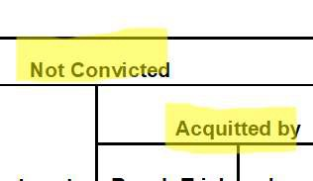
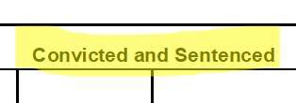
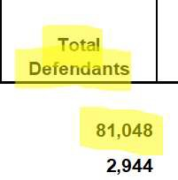


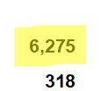
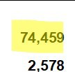
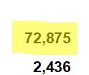
Table D-4.
U.S. District Courts—Criminal Defendants Disposed of, by Type of Disposition and Offense, During the 12-Month Period Ending December 31, 2018
Total
Dismissed
Not Convicted
Acquitted by
Total
Convicted and Sentenced
Plea of Guilty
Convicted by
Offense
Total
Defendants
81,048
2,944
Bench Trial
Jury Trial
Bench Trial
Jury Trial
79 |  |  |  |  | 235 | 138 |  |  | 1,446
Offenses, Total 10 |  |  |  |  | 38 | 9 |  |  | 133
Homicide | 128 | 24 | 20 | - | 4 | 104 | 90 | - | 14
Robbery | 741 | 16 | 12 | 1 | 3 | 725 | 705 | 2 | 18
Bank | 689 | 15 | 11 | 1 | 3 | 674 | 655 | 2 | 17
Other Robbery Offenses | 52 | 1 | 1 | - | - | 51 | 50 | - | 1
Assault | 1,067 | 243 | 219 | 7 | 17 | 824 | 788 | 7 | 29
Kidnapping | 90 | 13 | 9 | - | 4 | 77 | 58 | - | 19
Racketeering | 672 | 31 | 26 | 1 | 4 | 641 | 606 | - | 35
Carjacking | 101 | 21 | 16 | - | 5 | 80 | 74 | - | 6
Terrorism | 50 | 5 | 4 | - | 1 | 45 | 40 | - | 5
Other Violent Offenses | 95 | 13 | 12 | 1 | - | 82 | 75 | - | 7
Property Offenses, Total | 10,084 | 1,062 | 1,018 | 10 | 34 | 9,022 | 8,650 | 12 | 360
Burglary | 27 | 1 | 1 | - | - | 26 | 26 | - | -
Larceny and Theft | 1,481 | 419 | 414 | 2 | 3 | 1,062 | 1,029 | 1 | 32
Bank | 27 | - | - | - | - | 27 | 27 | - | -
Postal Service | 209 | 16 | 16 | - | - | 193 | 192 | - | 1
Interstate Shipments | 12 | - | - | - | - | 12 | 12 | - | -
Theft of U.S. Property | 1,060 | 353 | 348 | 2 | 3 | 707 | 681 | - | 26
Theft Within Maritime Jurisdiction | 74 | 33 | 33 | - | - | 41 | 40 | 1 | -
Transportation of Stolen Property | 85 | 13 | 13 | - | - | 72 | 67 | - | 5
Other Larceny and Theft Offenses | 14 | 4 | 4 | - | - | 10 | 10 | - | -
Embezzlement | 339 | 22 | 22 | - | - | 317 | 311 | - | 6
Bank | 42 | 1 | 1 | - | - | 41 | 38 | - | 3
Postal Service | 151 | 13 | 13 | - | - | 138 | 138 | - | -
Financial Institutions | 18 | - | - | - | - | 18 | 18 | - | -
Other Embezzlement Offenses | 128 | 8 | 8 | - | - | 120 | 117 | - | 3
Fraud | 7,782 | 550 | 514 | 7 | 29 | 7,232 | 6,908 | 10 | 314
Tax | 402 | 14 | 13 | - | 1 | 388 | 365 | - | 23
Financial Institutions | 417 | 33 | 32 | - | 1 | 384 | 368 | - | 16
Securities and Exchange | 67 | 9 | 7 | - | 2 | 58 | 48 | 1 | 9
Mail | 220 | 19 | 19 | - | - | 201 | 186 | 1 | 14
Wire, Radio, or Television | 695 | 48 | 40 | 2 | 6 | 647 | 618 | 1 | 28
Total
Violent
6,589
366
6,275
318
74,459
2,578
72,875
2,436
Printed on: 17/01/19
1 of 4

Slide 7
EXCERPT FROM WEBSITE OF NJ ATTORNEY GENERAL:
AG Grewal and Colonel Callahan Issue Daily COVID-19 Enforcement Update
TRENTON – Attorney General Gurbir S. Grewal and Colonel Patrick J. Callahan, Superintendent of the New Jersey State Police, announced the following recent enforcement actions related to COVID-19, including those involving individuals in violation of Governor Murphy’s Executive Order 107:
…
Kim Pagan of Toms River was charged by the New Jersey State Police with violating the emergency orders by organizing a prohibited event today in Trenton in which protesters gathered outside the State House and at other locations in Trenton to demonstrate against the Governor’s Executive Orders.
1

Slide 8

COVID-19 Update
Gov. Murphy announces additional business + construction restrictions. Learn MoreLink Opens in New Tab
Ask Your COVID-19 Questions Here
Submit a Search
DATA DASHBOARD
FEELING UNWELL? CHECK YOUR SYMPTOMS
JOBS PORTAL
HELP NJ
Back to All FAQs
How can I report a violation of an Executive Order?
Copy Link to Article
You can report a possible violation of any Executive Order using this online form: https://covid19.nj.gov/violation.
Some examples of Executive Order violations include: A non-essential business that is operating
A non-essential construction project
A business that is not practicing social distancing requirements
A business that is not allowing remote work of non-essential employees A prohibited gathering of people
Compliance with Executive Orders is not voluntary.
Updated: 4/11/20 Source: Executive Orders
•
•
•
•
•
Link Opens in New Tab Link Opens in New Tab TwitterLink Opens in New TabFacebookLink Opens in New TabNew Jersey Office of Innovation + LabLink Opens in New Tab
Legal StatementLink Opens in New Tab | Privacy PolicyLink Opens in New Tab
Made with by theNJ Office of InnovationLink Opens in New Tab+
1

Slide 9
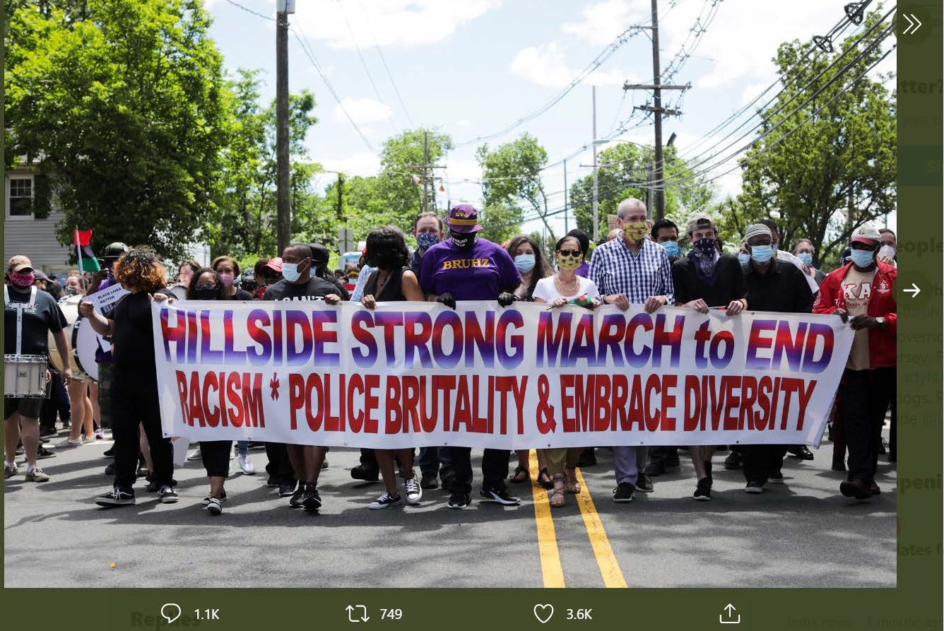

Governor Phil Murphy0
@GovMurphy
V
Today, in Hillsid e, we marched for justice.
For George Floyd and for the many before him - who lost their lives for being Black.
We march because we will not accept systemic racism and bias as just part of our national condition. Black Lives Matter.
2:37 PM • Jun 7, 2020 • Twitt er for iPhone
749 Retweets
3.6K Likes
0
,: .. .,...,; ,..o c A O t: ") C '7 rn,r:..
. I, ,... 7
,,, ....

Slide 10
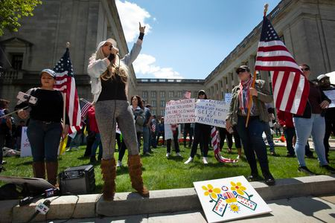
Drop charges against protest organizers who violated
coronavirus lockdowns, N.J. AG
says
Updated Jun 18, 2020; Posted Jun 18, 2020
Thursday, May 7, 2020 - Ayla Wolf speaks to those assembled at an "Open New Jersey Now" rally on West State Street outside the Statehouse Annex.Michael Mancuso | NJ Advance Media for NJ.com
Facebook Share Twitter Share
1,237
shares
By Jeff Goldman | NJ Advance Media for NJ.com
New Jersey’s attorney general has directed prosecutors to drop the charges against five people who organized protests or outdoor religious gatherings and were cited for violating Gov. Phil Murphy’s coronavirus-related executive order on large gatherings.
Attorney General Gurbir S. Grewal also said municipal prosecutors should move forward with their cases against people who cited for violating executive orders not related to protests or religious ceremonies, but suggested they use discretion
in the outcomes. Murphy routinely call out those cited as “knuckleheads” during his coronavirus briefings.
In releasing guidance Wednesday on municipal court prosecutions of COVID-19 related offense, Grewal noted that no individual protestors or worshipers have

